Slide 1
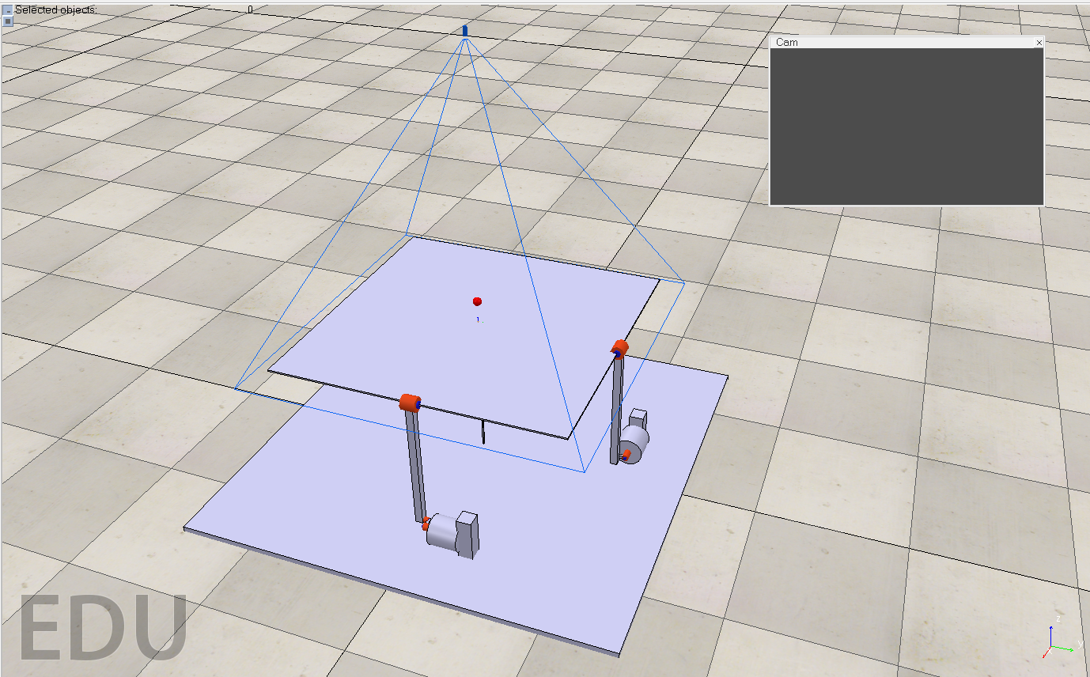
Ball and Plate
Group:
Aaron Dizon
Haitham Mohamed
Giovanni Paredes
Allan Del Rosario
Linda Tsafack

Slide 2
Project Description
For this project we used a controller to help balance a ball on a plate system that must be designed using Matlab, Simulink and Coppelia. The overall goal of this system is keep a ball balanced at the center of the plate and must be able to react accordingly to the ball’s position to avoid the ball rolling off the plate.

Slide 3
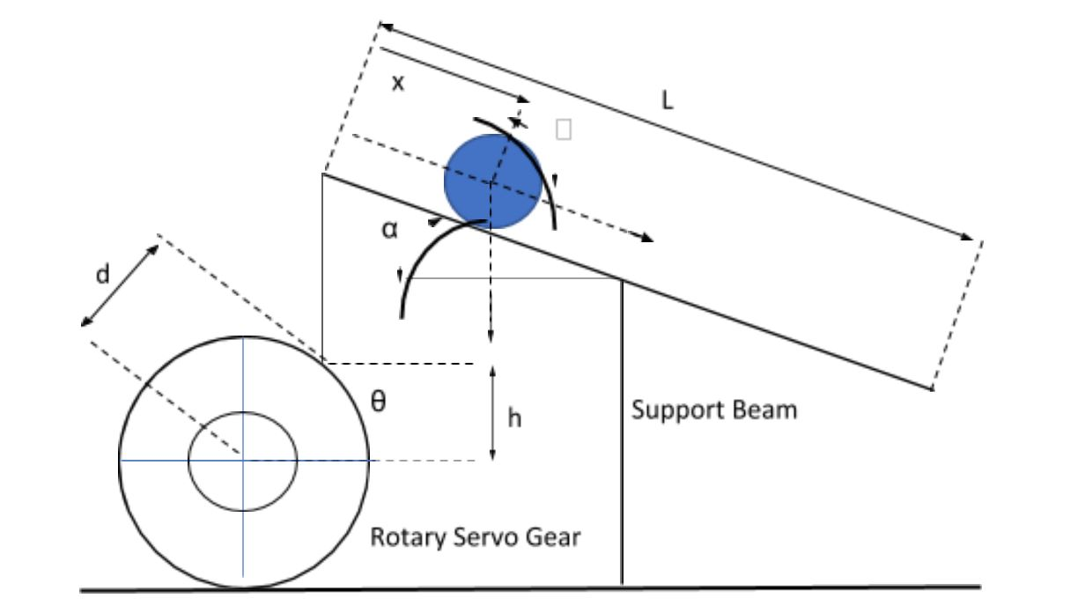
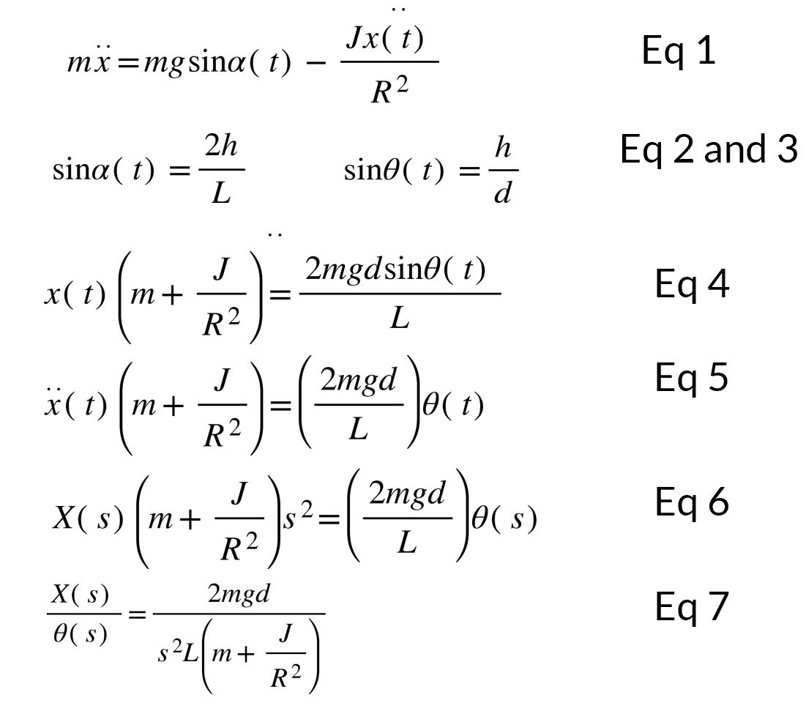
Modeling
Equations:

Slide 4
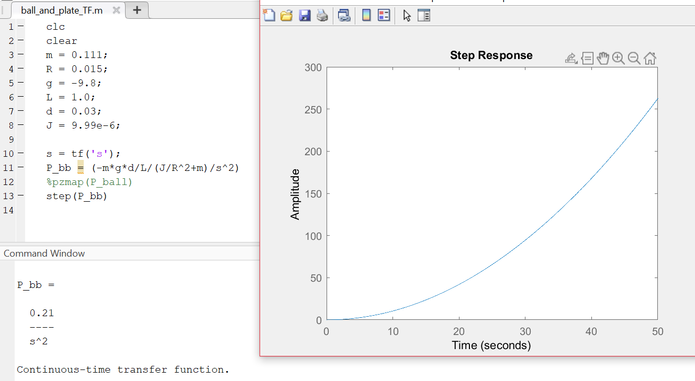
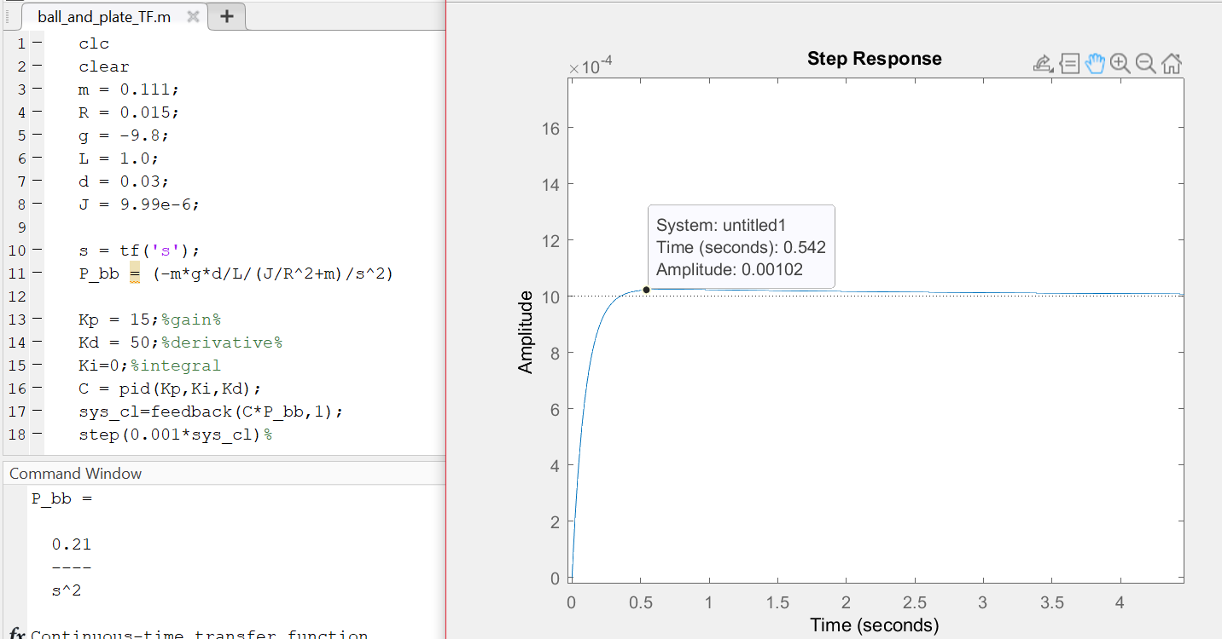
PID Controller

Slide 5
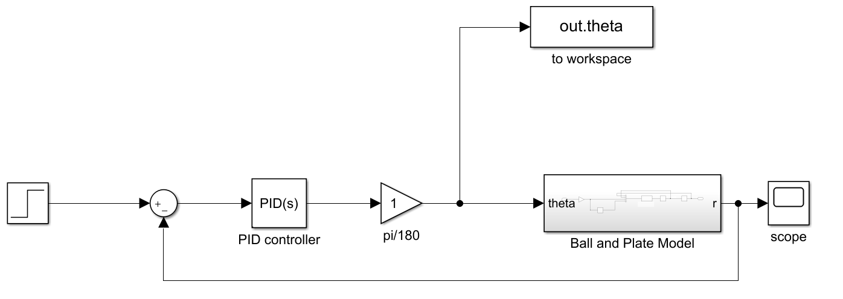
Simulink Model of the System

Slide 6
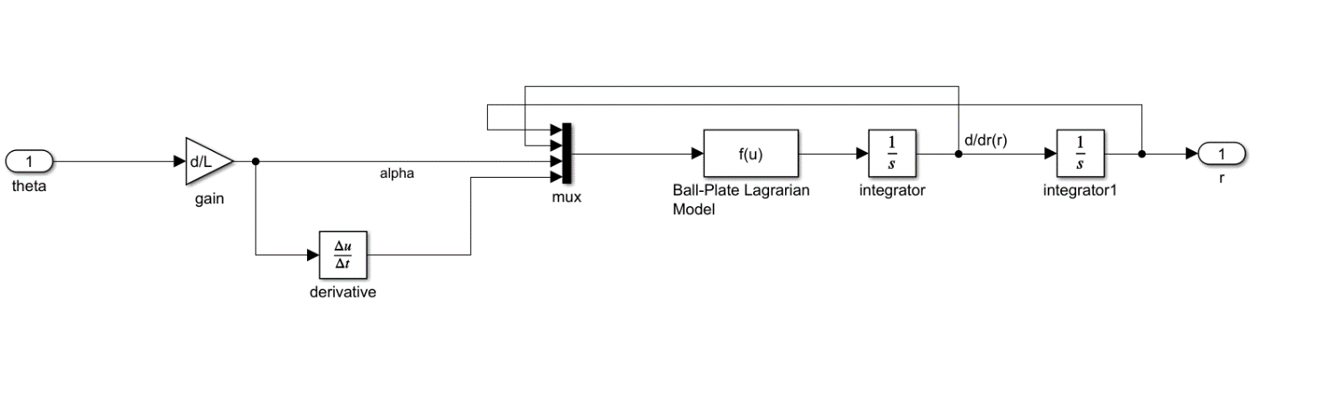
Ball and Beam Simulink Model

Slide 7
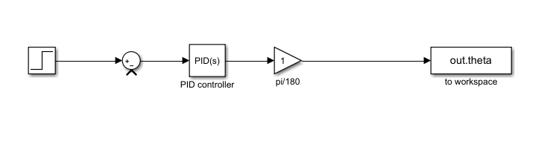
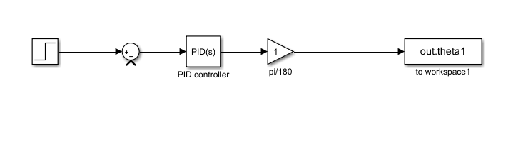
Simulink Model Used With Coppelia

Slide 8
COPPELIA simulation
CoppeliaSim model provided by Sinan Bank.

